Slide 1
Examining the news media’s treatment of the COVID-19 death milestones
Valentina Neblitt-Jones
CS 895 Web Archiving Forensics – Fall 2020
October 22, 2020
vneblitt@gmail.com

Slide 2
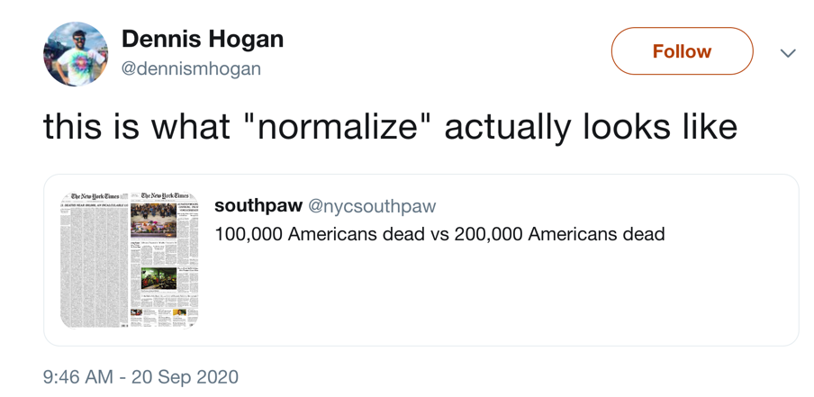
Is the News Media Normalizing Death?
https://web.archive.org/web/20200921023939/https://twitter.com/dennismhogan/status/1307722852066525186

Slide 3
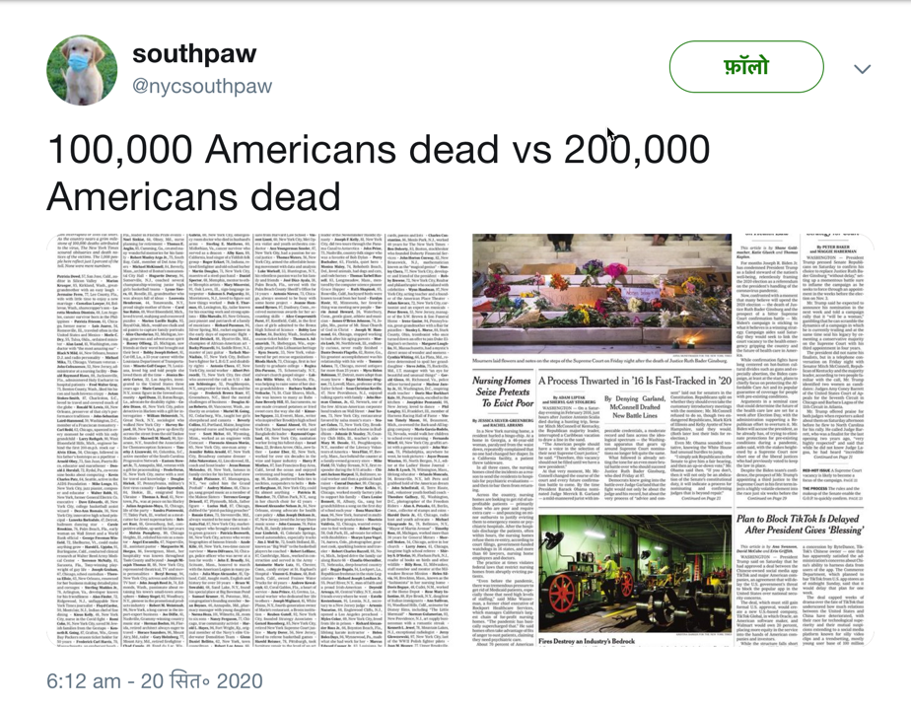
@nycsouthpaw tweet that was quoted by @dennismhogan
Left image shows a full page of names of people who have died due to COVID-19 in the New York Times near the 100,000 milestone (May 24, 2020).
Right image shows a New York Times front page near the 200,000 milestone (Sep 20, 2020). The milestone is not featured on this page.
But those dates are not the milestone dates.
https://web.archive.org/web/20201018234135/https://twitter.com/nycsouthpaw/status/1307668885009772546

Slide 4
When did we reach the two milestones?

Slide 5
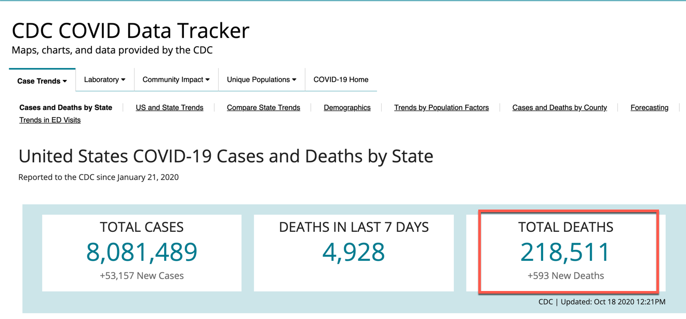
CDC has a COVID-19 dashboard - Source #1 for finding the milestone dates
https://covid.cdc.gov/covid-data-tracker/#cases_totaldeaths
Notes:
Source #1 for total deaths data. This source is relatively simple compared to JHU data.

Slide 6

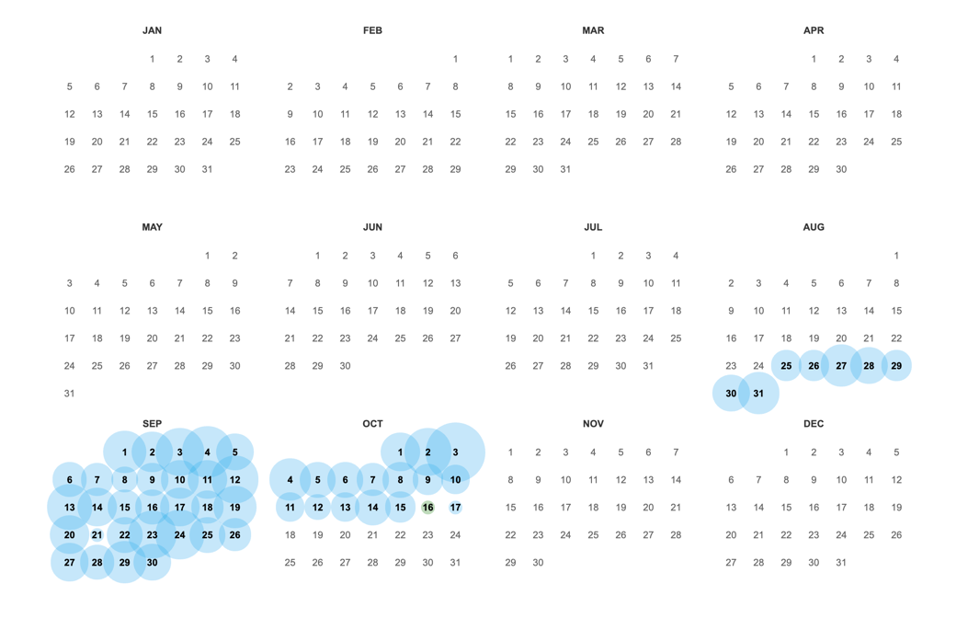
Did not find any mementos for the CDC COVID Data Tracker before August 25
Carbon date tool indicates the site was born on 3/28/2020
http://carbondate.cs.odu.edu/#https://covid.cdc.gov/covid-data-tracker/
https://web.archive.org/web/*/https://covid.cdc.gov/covid-data-tracker/#cases_totaldeaths
Notes:
Did not find them with timetravel.memento.org either.

Slide 7
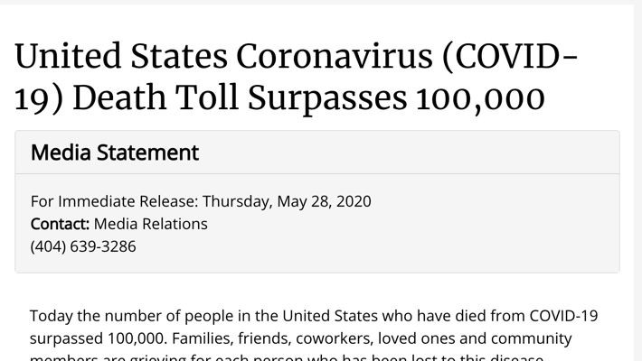
CDC posted an official press release on May 28, 2020 declaring we reached 100,000 deaths
Had to use this as their milestone #1 date because there are no captures of CDC COVID-19 data before August 25.
https://www.cdc.gov/media/releases/2020/s0528-coronavirus-death-toll.html

Slide 8
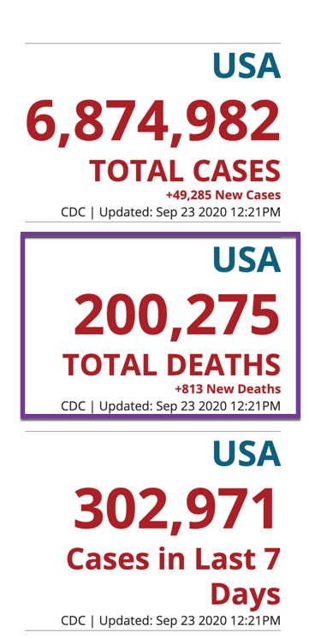
Milestone #2 according to CDC – Sep 23, 2020
Sep 23 2020 12:21PM
Memento Datetime | Total Deaths
Sep 19 2020 12:46pm | 198,099
Sep 20 2020 2:40pm | 198,754
Sep 21 2020 12:16pm | 199,024
Sep 22 2020 12:16pm | 199,462
Sep 23 2020 12:21pm | 200,275
CDC did not post a press release for this milestone, but I was able to use captures of the data tracker for this milestone.
https://web.archive.org/web/20200923172039/https://covid.cdc.gov/covid-data-tracker/#cases_casesinlast7days

Slide 9
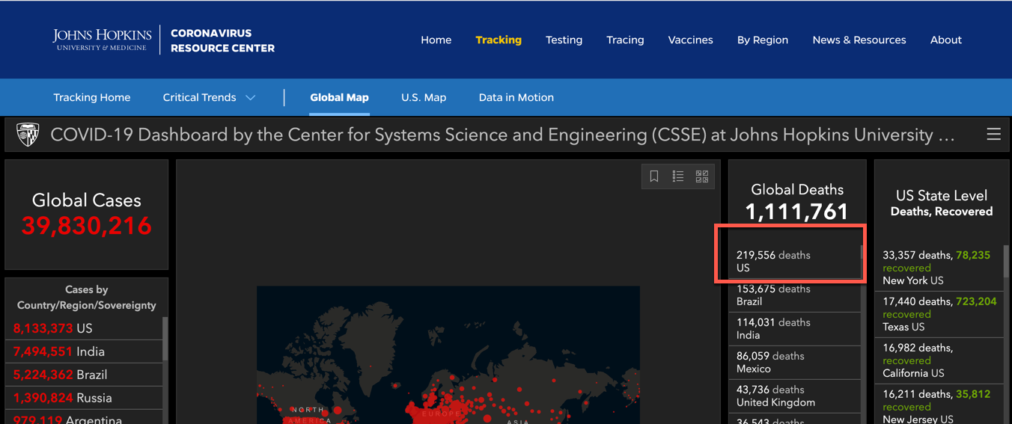
Johns Hopkins University also has a COVID-19 Dashboard – Source #2 for finding milestone dates
https://coronavirus.jhu.edu/map.html
Notes:
Source #2 for total death data

Slide 10
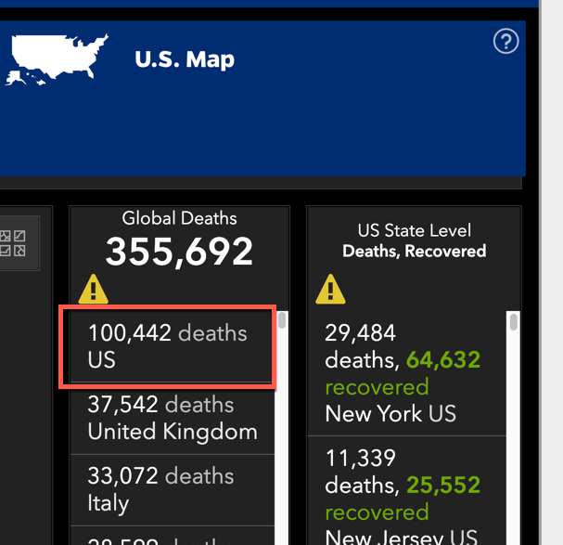

Milestone #1 according to JHU – May 28, 2020
When Captured | Total Deaths
24 May 2020 06:08:35 UTC | 97,087
25 May 2020 06:15:40 UTC | 97,722
26 May 2020 06:02:57 UTC | 98,223
27 May 2020 07:07:42 UTC | 98,929
28 May 2020 06:11:38 UTC | 100,442
http://archive.is/yyaT7

Slide 11
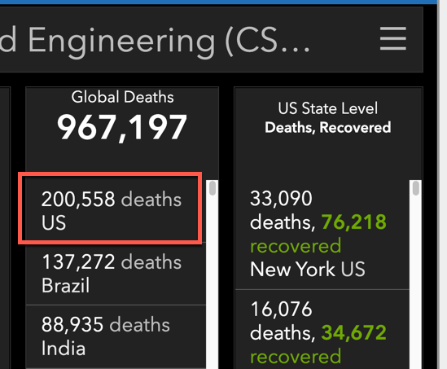

Milestone #2 according to JHU – Sep 22, 2020
Memento Datetime | Total Deaths
18 Sep 2020 15:42:32 UTC | 197,266
21 Sep 2020 16:17:48 UTC | No data
22 Sep 2020 22:13:57 UTC | 200,558
http://archive.is/f2jlt

Slide 12
Which days to study news coverage
100,00 deaths
May 28 – JHU & CDC
200,000 deaths
Sep 22 - JHU
Sep 23 - CDC
Use the CDC press release and the captures from JHC and CDC, I was able to narrow the dates to focus on.
Moved forward and backward through those dates to find the first occurrence of reaching the milestone.

Slide 13
Which news sources to include in the study
LEFT | CENTER | RIGHT
Politics USA | CNN | Washington Examiner
Vox | Politico | Fox News
Huffington Post | ABC News | Daily Caller
MSNBC | The Hill | Conservative Tribune
New York Times | Real Clear Politics | Breitbart
Washington Post |  | The Gateway Pundit
365 Dots in 2019: Quantifying Attention of News Sources (from Table 1)
https://arxiv.org/abs/2003.09989

Slide 14
Ranking criteria
Things considered
Enormous font/bigger
Inclusion of photo & size of photo
Position/layout (top of page, centered and large, left to right)
Is it in an “article basket”?
Group page content into blocks
Things not considered
Live streams
Video stories/video clips
Opinion pieces
Ads
Measuring News Similarity Across Ten U.S. News Sites
https://arxiv.org/abs/1806.09082

Slide 15
Milestone #1 – 100,000 deaths

Slide 16
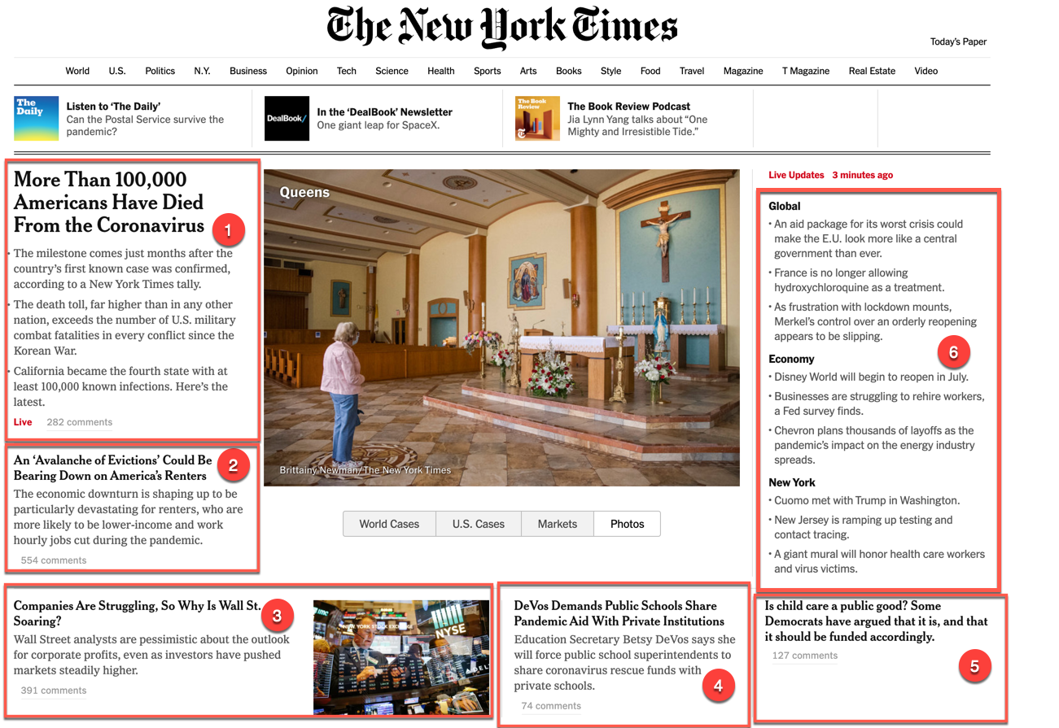
New York Times – May 27, 2020 @ 20:01 UTC
Left
MRR | 1
Precision | 1/6
nDCG | 1.00
https://web.archive.org/web/20200527200119/https://www.nytimes.com/

Slide 17
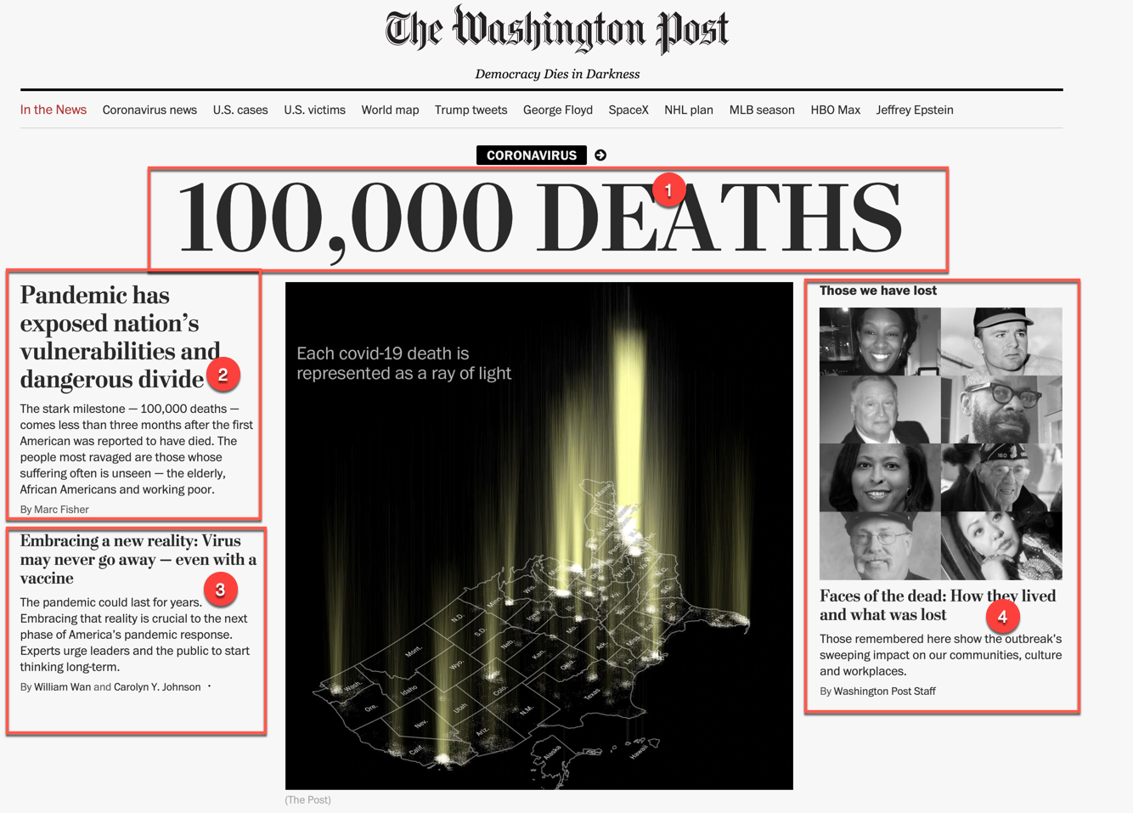
Washington Post – May 27, 2020 @ 23:03 UTC
Left
MRR | 1
Precision | 2/5
nDCG | 1.00
https://web.archive.org/web/20200527230346/https://www.washingtonpost.com/
Notes:
First capture - https://web.archive.org/web/20200527221101/https://www.washingtonpost.com/ - did not render the stylesheet
Found captures very early on May 28 which caused me to check May 27.

Slide 18
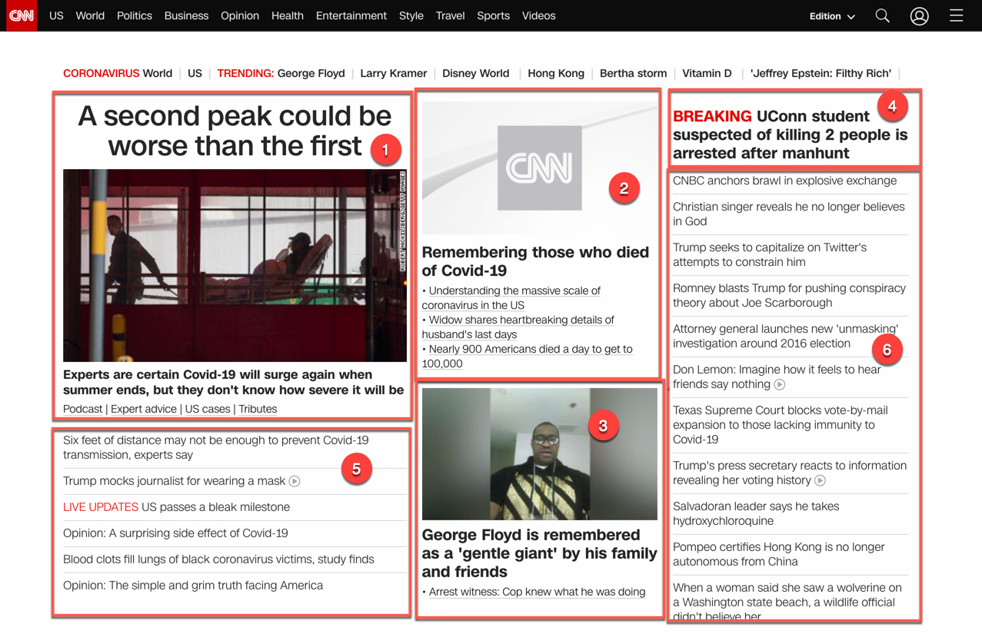
CNN – May 28, 2020 @ 01:21 UTC
Center
MRR | 1/2
Precision | 2/6
nDCG | 0.76
https://web.archive.org/web/20200528012103/https://www.cnn.com/
Notes:
CNN May 28, 2020 @ 08:44:30
https://web.archive.org/web/20200528084430/https://www.cnn.com/
reporting about how Fox News is not reporting18

Slide 19

ABC News – May 27, 2020 @ 22:10 UTC
Center
MRR | 1
Precision | 2/5
nDCG | 0.77
https://web.archive.org/web/20200527221043/https://abcnews.go.com/

Slide 20

Washington Examiner – May 28, 2020 @ 01:14 UTC
Right
MRR | 1
Precision | 1/2
nDCG | 1.00
https://web.archive.org/web/20200528014101/https://www.washingtonexaminer.com/

Slide 21

Fox News – May 27, 2020 @ 22:13 UTC
Right
MRR | 1
Precision | 1/7
nDCG | 1.00
https://web.archive.org/web/20200527221303/https://www.foxnews.com/

Slide 22
Milestone #1 – Within a 5 hour time period
New York Times | Left | May 27, 2020 @ 20:01 UTC
ABC News | Center | May 27, 2020 @ 22:10 UTC
Fox News | Right | May 27, 2020 @ 22:13 UTC
Washington Post | Left | May 27, 2020 @ 23:03 UTC
Washington Examiner | Right | May 28, 2020 @ 01:14 UTC
CNN | Center | May 28, 2020 @ 01:21 UTC

Slide 23
Milestone #2 – 200,000 deaths

Slide 24
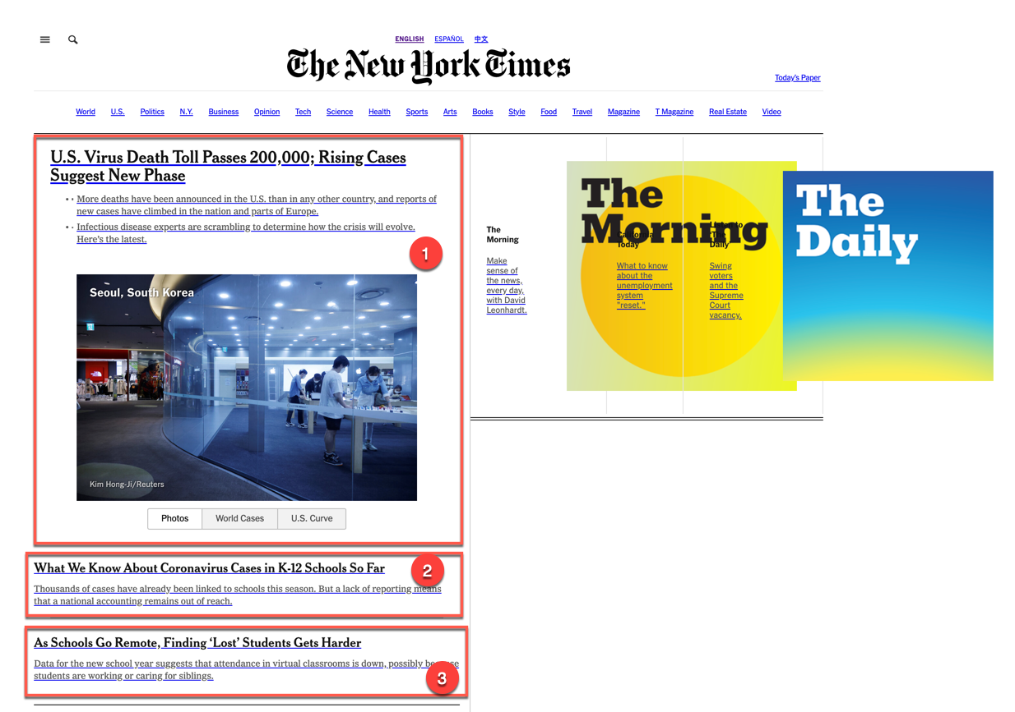
New York Times - Sep 22, 2020 @ 16:52 UTC
Left
MRR | 1
Precision | 1/3
nDCG | 1.00
https://web.archive.org/web/20200922165205/https://www.nytimes.com/

Slide 25

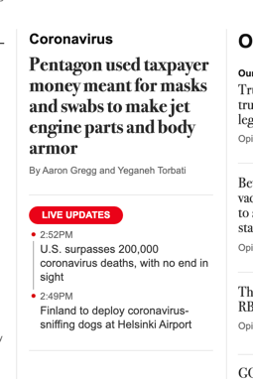
Washington Post – Sep 22, 2020 @ 18:55 UTC
Left
MRR | 1/4
Precision | 1/10
nDCG | 0.39
https://web.archive.org/web/20200922185544/https://www.washingtonpost.com/

Slide 26
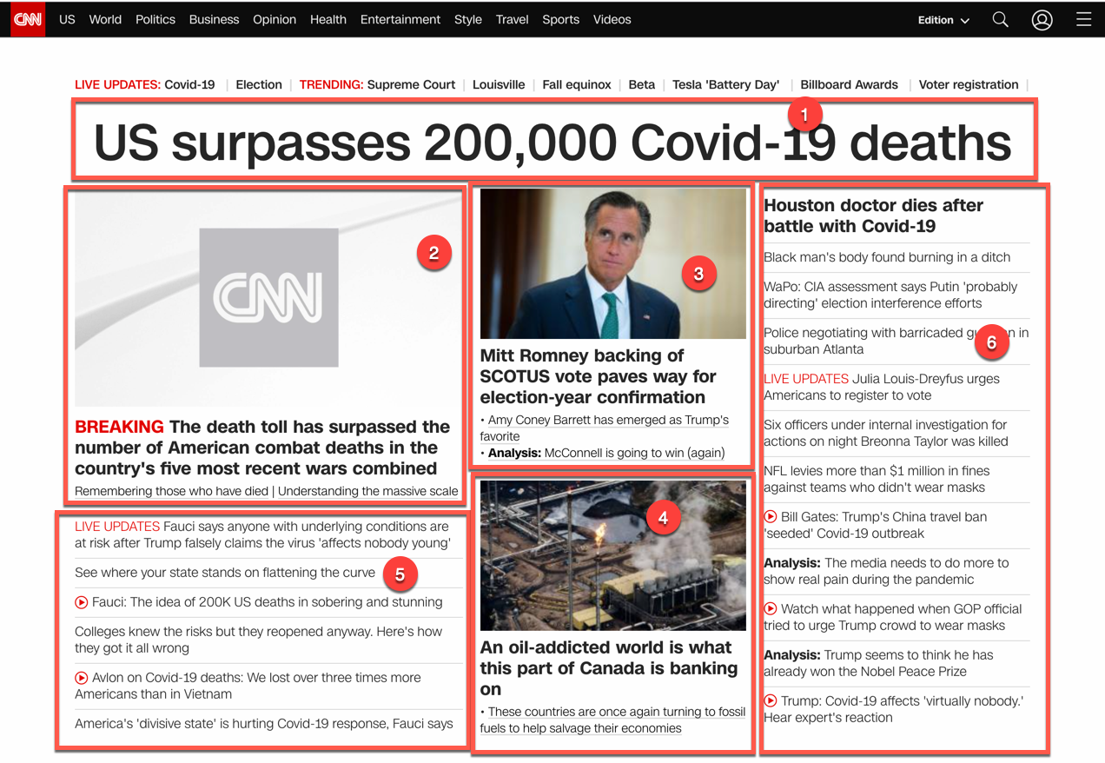
CNN – Sep 22, 2020 @ 15:50 UTC
Center
MRR | 1
Precision | 3/6
nDCG | 0.85
https://web.archive.org/web/20200922155024/https://www.cnn.com/

Slide 27

ABC News – Sep 22, 2020 @ 16:07 UTC
Center
MRR | 1
Precision | 2/5
nDCG | 0.77
https://web.archive.org/web/20200922160725/https://abcnews.go.com/

Slide 28

Washington Examiner – Sep 22, 2020 @ 16:09 UTC
Right
MRR | 1/3
Precision | 1/6
nDCG | 0.46
https://web.archive.org/web/20200922160917/https://www.washingtonexaminer.com/

Slide 29

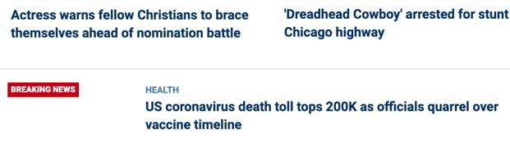
Fox News – Sep 22, 2020 @ 16:02 UTC
Right
MRR | 1/6
Precision | 1/7
nDCG | 0.44
https://web.archive.org/web/20200922160224/https://www.foxnews.com/

Slide 30
Milestone #2 – Within a 4 hour time period
CNN | Center | Sep 22, 2020 @ 15:50 UTC
Fox News | Right | Sep 22, 2020 @ 16:02 UTC
ABC News | Center | Sep 22, 2020 @ 16:07 UTC
Washington Examiner | Right | Sep 22, 2020 @ 16:09 UTC
New York Times | Left | Sep 22, 2020 @ 16:52 UTC
Washington Post | Left | Sep 22, 2020 @ 18:55 UTC

Slide 31
Metrics Calculated
Query:
Does the article talk about reaching the COVID-19 milestone?
Captures were treated like a search engine results page
Mean Reciprocal Rank (MRR) – how “fast” did I get the expected result (i.e. was my query the top item)
Precision – how much coverage did my query get (i.e. how many of the results were about my query)
Normalized Discounted Cumulative Gain (nDCG) – how far away from ideal was my result

Slide 32
Mean Reciprocal Rank (MRR)
News Outlet | Leaning | Milestone #1 | Milestone #2 | Judgment
New York Times | Left | 1 | 1 | Same
Washington Post | Left | 1 | 1/4 | Worse
CNN | Center | 1/2 | 1 | Better
ABC News | Center | 1 | 1 | Same
Washington Examiner | Right | 1 | 1/3 | Worse
Fox News | Right | 1 | 1/6 | Worse
Washington Post, Washington Examiner, and Fox News decreased between the milestones.
CNN improved between the milestones.

Slide 33
Precision
News Outlet | Leaning | Milestone #1 | Milestone #2 | Judgment
New York Times | Left | 1/6 | 1/3 | Better
Washington Post | Left | 2/4 | 1/10 | Worse
CNN | Center | 2/6 | 3/6 | Better
ABC News | Center | 2/5 | 2/5 | Same
Washington Examiner | Right | 1/2 | 1/6 | Worse
Fox News | Right | 1/7 | 1/7 | Same
Washington Post and Washington Examiner decreased between the milestones.
New York Times and CNN improved between the milestones.

Slide 34
Normalized Discounted Cumulative Gain (nDCG)
News Outlet | Leaning | Milestone #1 | Milestone #2 | Judgment
New York Times | Left | 1.00 | 1.00 | Same
Washington Post | Left | 1.00 | 0.39 | Worse
CNN | Center | 0.76 | 0.85 | Better
ABC News | Center | 0.77 | 0.77 | Same
Washington Examiner | Right | 1.00 | 0.46 | Worse
Fox News | Right | 1.00 | 0.44 | Worse
Washington Post, Washington Examiner, and Fox News decreased between the milestones.
CNN improved between the milestones.

Slide 35
Summary
None of the news outlets were excessively later than others with breaking the news.
Milestone #1 within a 5 hour period; milestone #2 within a 4 hour period
Top Story (decrease)
5 of the 6 had the story as their top story for Milestone #1
3 of the 6 has the story as their top story for Milestone #2
Coverage (mixed)
3 of the 6 had one story about it about Milestone #1; the remaining 3 had more than one story
4 of the 6 had one story about it about Milestone #2; the remaining 2 had more than one story
Ideal World (decrease)
4 of the 6 got a perfect score for Milestone #1
1 of the 6 got a perfect score for Milestone #2

